Slide 1

The Prosper Loans Revival
By: Hayden Allison
2/17/24

Slide 2



Agenda
Predicting Applications
Empowering Profits
The Future of Loan Conditions
Recommendations

Slide 3

Fair Approval Judgement
Customers appreciate which 2 principles most?
1. Sense of trust
2. Respectable treatment
Thousands of loan applications are routinely processed
15% are wrongfully denied
15% are mistakenly approved

Slide 4
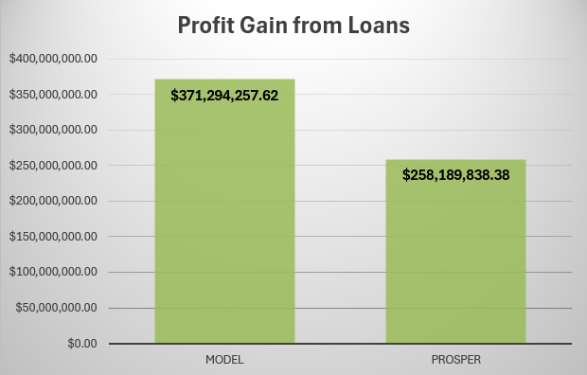
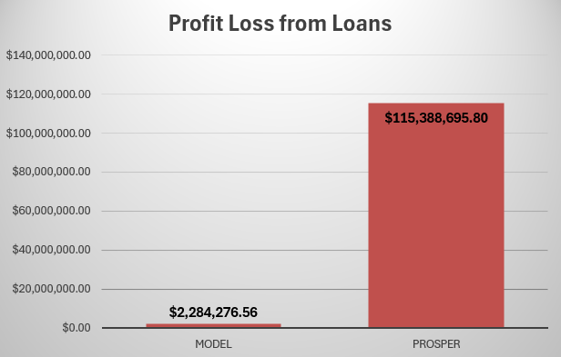
Predicting Applications
Rigorously tested performance has procured a model that is accurate
99.4% of the time
Capitalizing on profit for 55,071 loans looks like

Slide 5
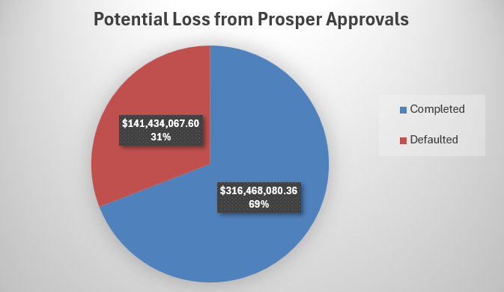
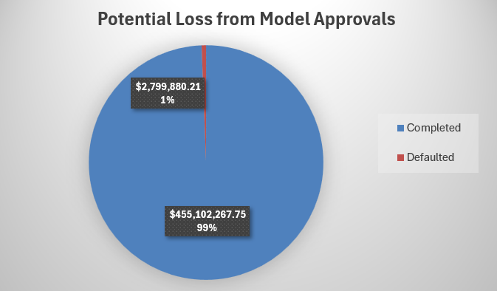
Investment is Risky
Loan defaults lose the potential profit and initial investment
17,010 have been defaulted on, losing up to
$141,434,068 of the initial investment, which could’ve been only $2,799,880

Slide 6
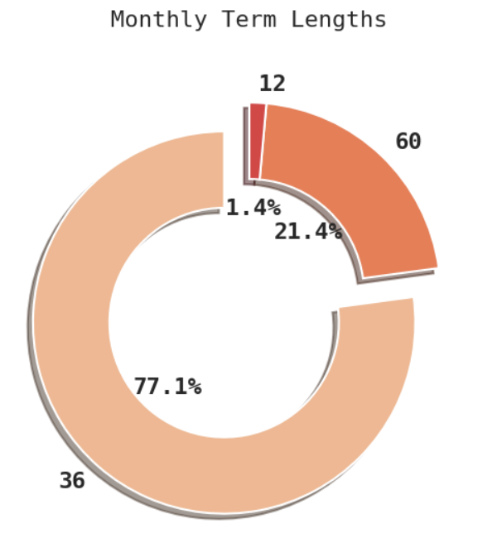
Empowering Profits
Input application data into the model. No more relying on an outdated method!
Improve customer retention by limiting false denials
Guarantee qualified individuals are approved
Introduce a 48-month term length
Profit, profit, profit!

Slide 7
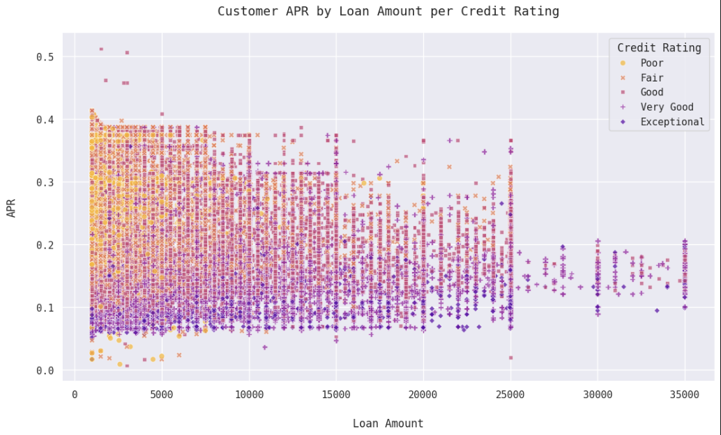
The Future of Loans Conditions
Satisfaction is directly connected to the customer’s perceived quality of their loan.
Credit rating is a metric for financial trustworthiness.
Take full advantage and reap the rewards!

Slide 8

Credit Rating Zoom in
Poor & Fair ratings should have the associated risk minimized by
high APR and low loan amounts
Good & above are lucrative opportunities that deserve
low APR and high loan amounts

Slide 9
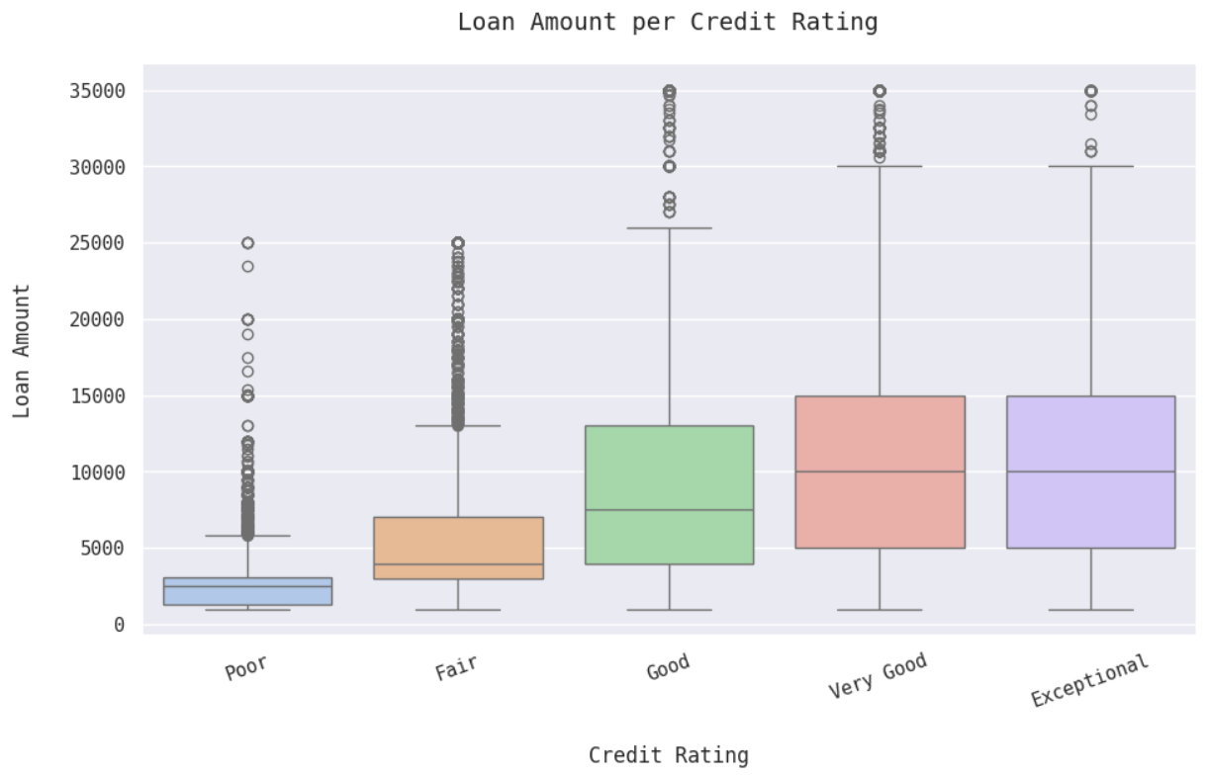

Slide 10
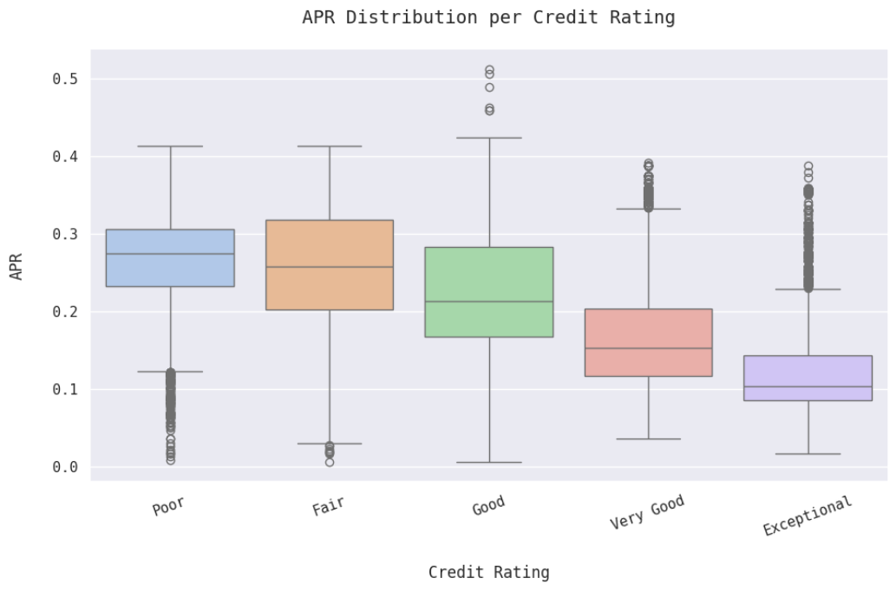

Slide 11
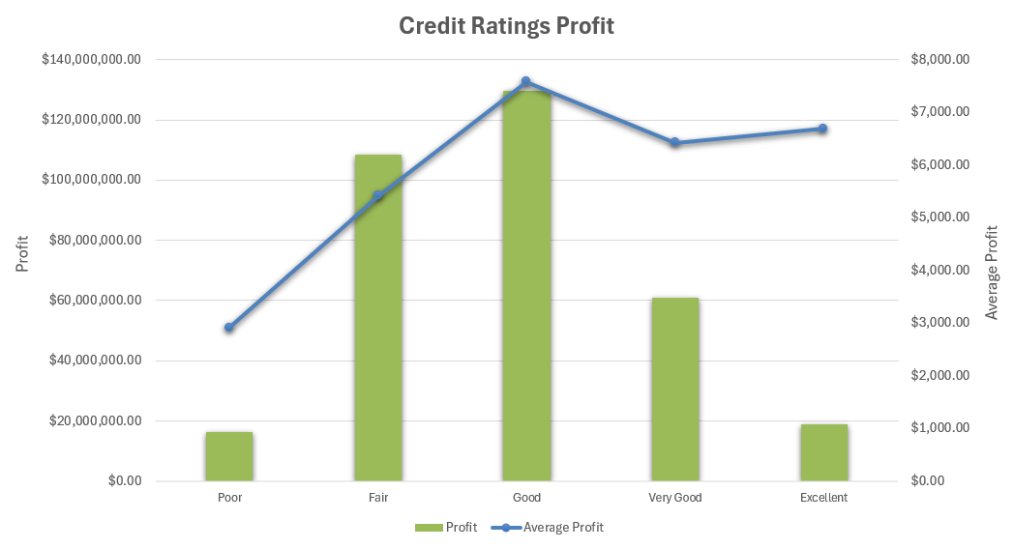
Value Recognized
Each rating has an average profit from competitive rates
When customers don’t receive market conditions, they:
avoid service, give no referrals, and submit bad feedback

Slide 12
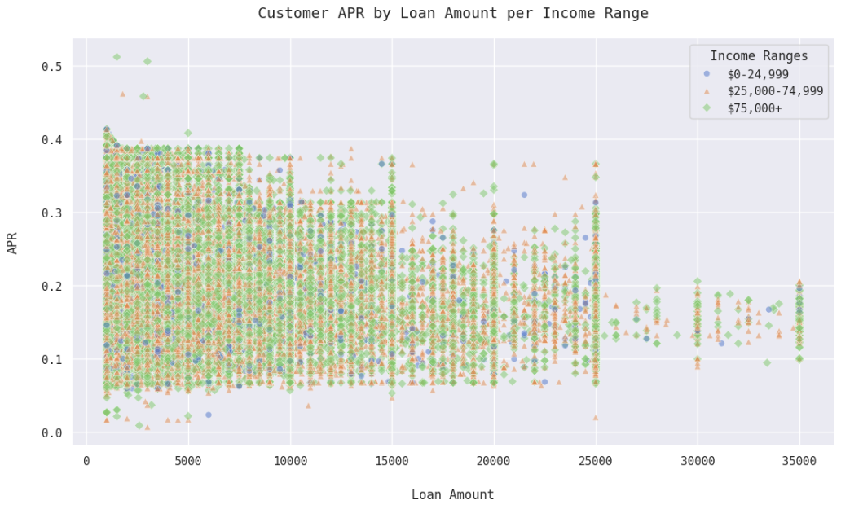
Value Unrecognized
Income range isn’t properly considered in assigning loan conditions
People who make more money
spend more $$$!
Follow the trails of
green breadcrumbs

Slide 13
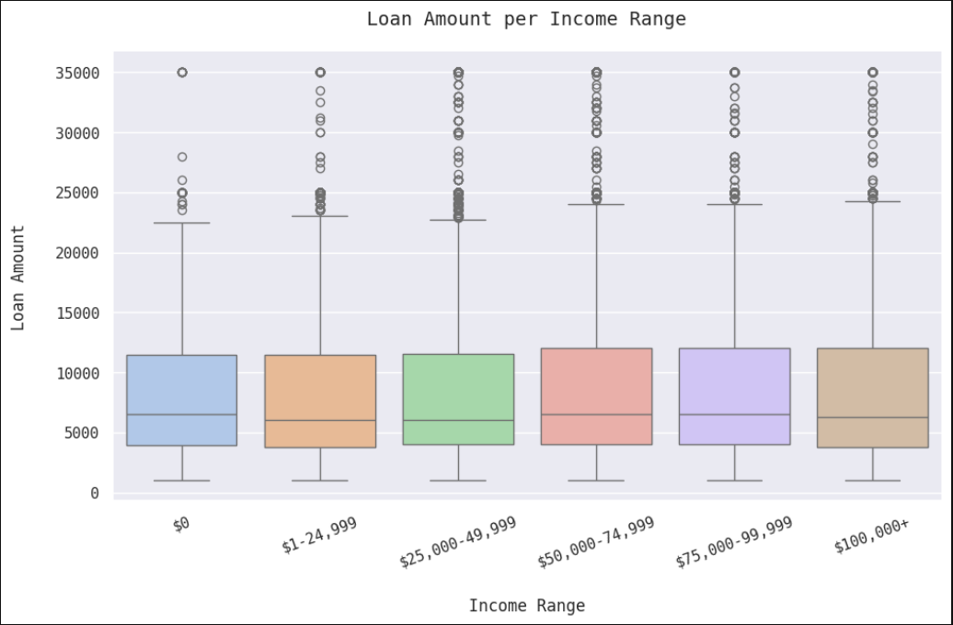

Slide 14
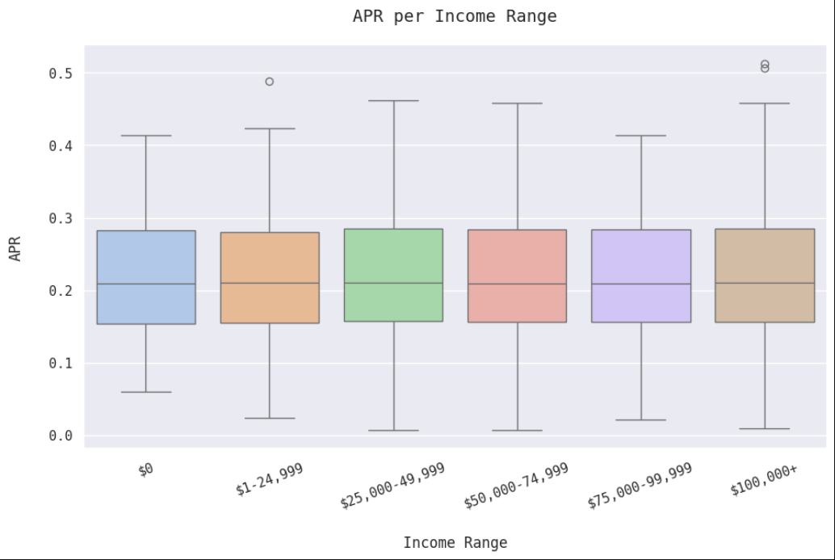

Slide 15

Customers are people, and people have expectations and unique qualities
Hayden Allison

Slide 16
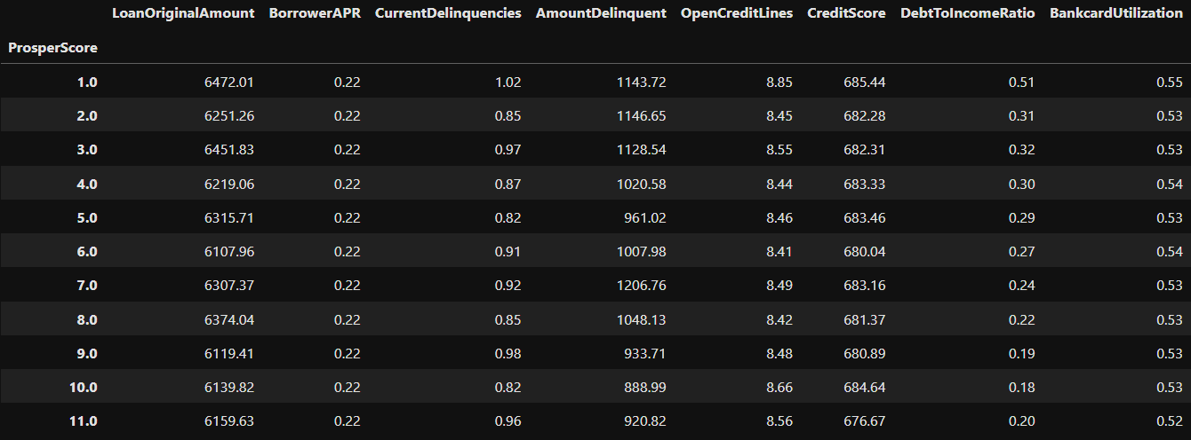
Prosper Score
Defined as a risk metric, but fails to consider common red flags

Slide 17
Recommendations
Integrate the Machine Learning model into Loan Approval process.
Offer a 48-month term length.
Customers with a lower income in the range of $0 - $24,999 or in an upper range of $75,000+ should be provided loan conditions that factor this in.
Lower range: max of $5,000 amount and above .25 APR.
Upper range: max is dependent on their income and under .20 APR.
4. Using Prosper Score as a metric for customer red flags like abnormal delinquencies.

